Slide 1
BUSINESS PROCESS REENGINEERING
Prepared by
Mustafa Shiraz Ahmed

Slide 2
The Idea of
Process
Concept: end- to- end work
Definition: an organized group of related tasks that work together to create a result of value
transformation of inputs into outputs
structured purposeful work

Slide 3
The Idea of
Process
Some common processes
  order fulfillment order acquisition
  procurement demand creation
  product development plan to produce
A sample process structure
  the architecture of order fulfillment
The indivisible triad of customer/ results/ process
  an iron triangle

Slide 4
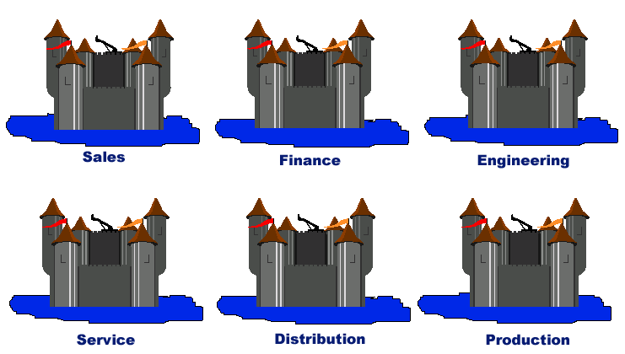
The Traditional
Organization

Slide 5
Processes in a
Traditional Organization
Fragmented
Buried
Undefined
Disjointed
Ad hoc
Informal
Complex
Chaotic
Disconnected
Haphazard
Implicit
Invisible
Uncoordinated
Unmanaged
Unrecognized
Unmeasured
Undesigned
Dysfunctional

Slide 6
The Nightmare of
Functionality
No discipline, structure, repeatability, reliability, consistency, predictability
Introspection and no customer focus
Lack of overall ownership, accountability, responsibility
Divergent goals, arguing, conflict
Hand- offs and delays
Non- value- adding costs

Slide 7
The Nightmare of
Functionality
Information attenuation
Low quality, errors, rework
Inflexibility and inconvenience
Complexity
Duplication
Lost opportunities

Slide 8
Why Worry Now?
Powerful customers with high expectations
Overcapacity
Intense competition
Global economy
Commoditization of products and services
Consolidation
Increased information availability
Theoretical choices becoming real

Slide 9
Approaches to Performance
Improvement
Automate/ mechanize
Reorganize
Outsource
Restructure
Exhort
Downsize/ cut costs

Slide 10
The Process Approach to Work
Focus on customers and outcomes instead of on managers
See work in end- to- end terms instead of narrowly
Define goals in customer terms instead of functionally
Follow carefully developed process designs instead of improvisation
Understand what others do instead of ignoring it
Align everyone around common objectives instead of divergence

Slide 11
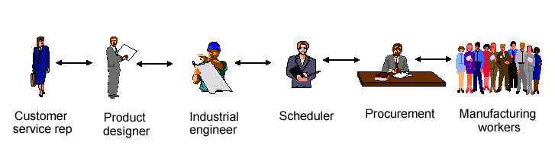
Absence of Process (Order Fulfillment)

Slide 12
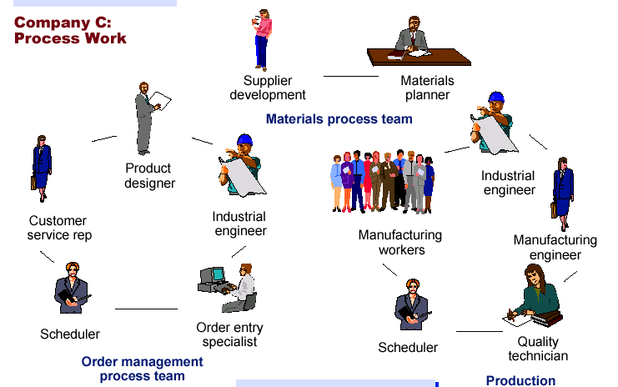
Process Work
(Order Fulfillment)

Slide 13
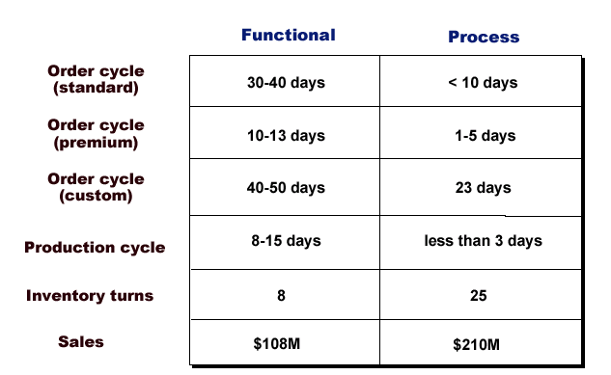
The Payoff

Slide 14
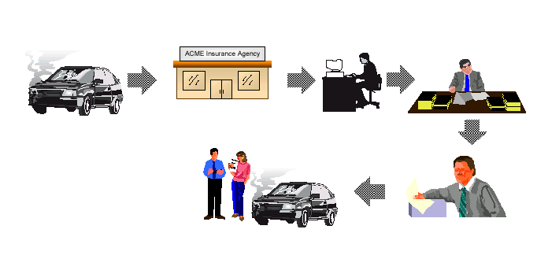
Task Work (Insurance)

Slide 15
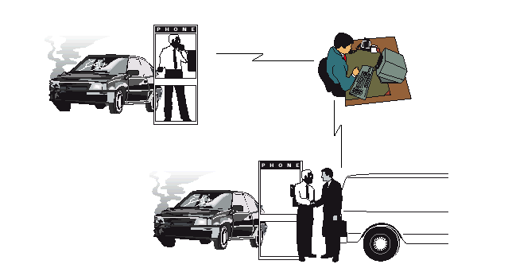
Process Work (Insurancce)

Slide 16
The Powers of Process
Design
  reduced overhead, increased speed, enhanced accuracy,
  improved asset utilization, greater responsiveness
  the antidote to inefficiency
Alignment
  process work is team work
  cooperation, ownership, accountability, avoiding sub-
  optimization, customer and outcome focus
  the antidote to conflict

Slide 17
The Powers of Process
Discipline
  any process is better than no process
  repeatability, consistency, predictability, clarity of action
  the antidote to chaos

Slide 18
Approach to Performance Improvement
Identify the organization’s processes
  a business model in process terms, driven by strategic goals
Measure process performance
  and set target goals
Create high- performance process designs
  specifying precisely how tasks fit together
  replacing inherited default designs

Slide 19
Approach to Performance Improvement
Implement new process designs
  training, infrastructure, and technology
Align everyone around processes
  thinking and behavior
Improve process performance
  on an ongoing basis

Slide 20
All Work is Process Work
Creates customer focus
Leads to appreciation of goals and objectives
Recognizes team contribution
Allows replication and predictability
Encourages broad understanding and
perspective
Lets people see where they fit in
Creates a sense of ownership
Supports measurement and improvement

